Slide 1
Pun and Visual Pun!
Creating Paper Mache Sculptures based on visual puns and humour

Slide 2
Key Words to Remember!

Slide 3
Pun
Pun: A joke or play on words exploiting the different possible meanings of a word, or the fact that there are words that sound alike but have different meanings.
Puns are fun!!

Slide 4
Visual Pun
Visual Pun: A drawing, cartoon, photograph, etc. depicting objects arranged so that the names of the objects or a description of their placement suggests a play on words

Slide 5
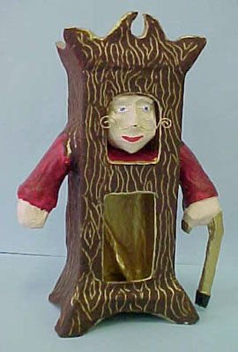
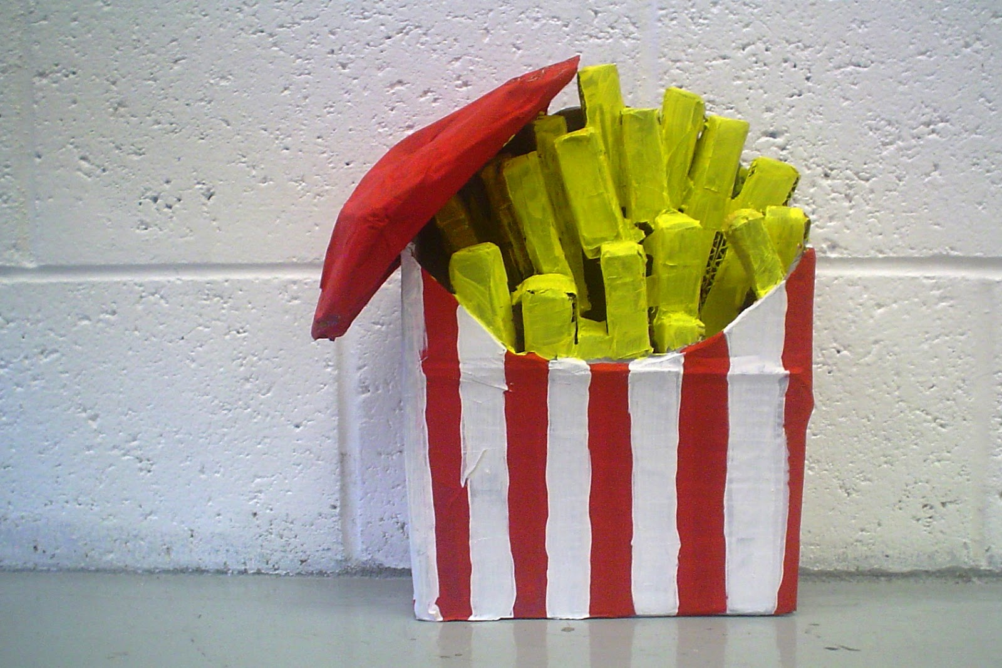
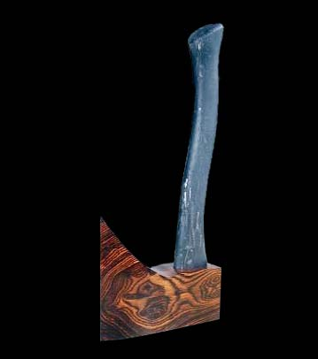

Slide 6
Paper Mache
Paper Mache: A substance made from paper pulp that can be moulded when wet and painted when dry

Slide 7
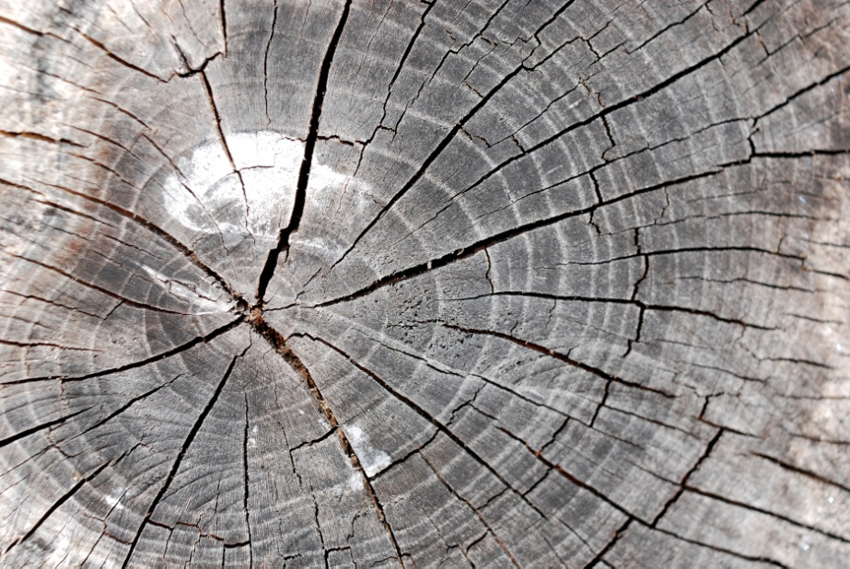
Texture
Texture: The surface quality of a shape – rough, smooth, soft, hard, glossy etc. Texture can be physical (tactile) or visual

Slide 8
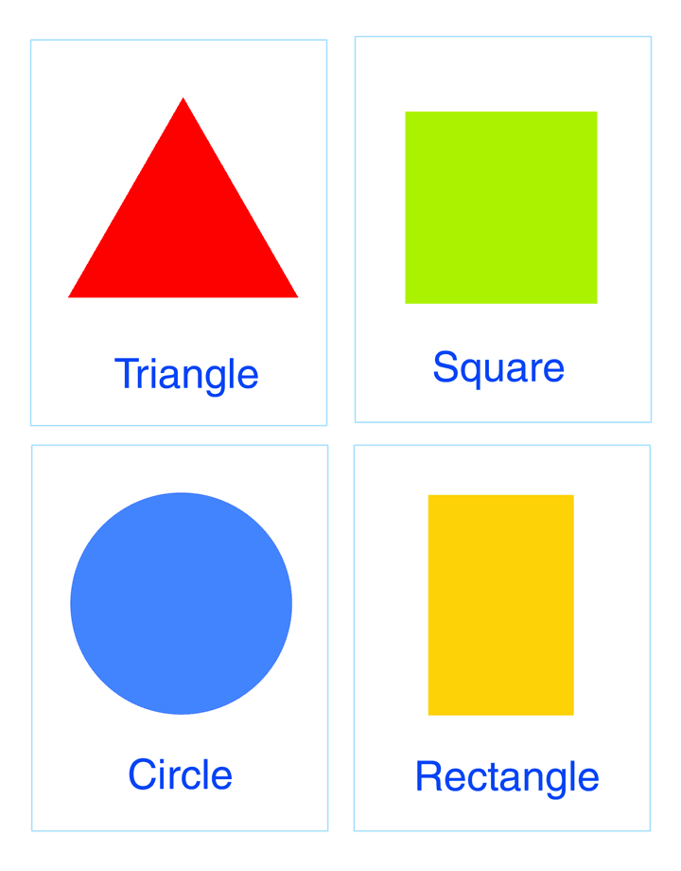
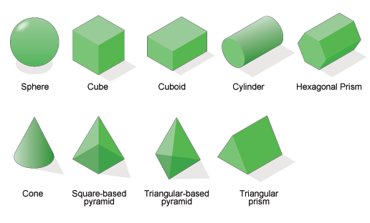
Shape
Shape/Form: A shape is a self contained defined area of geometric or organic form. A positive shape in a painting automatically creates a negative space

Slide 9
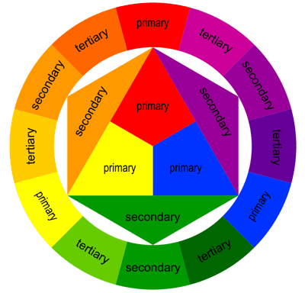
Colour
Colour: Also called a hue. Self-Explanatory

